Slide 1
Yuppy City Simulator
Meandering Armadillos:
Nick Montaquila, Michael Nishida, Andrew Ricci

Slide 2
Motivations

Slide 3


Motivations: Being a Yuppie
Many of us are about to become yuppies
Deciding where to live is difficult
How do we decide?

Slide 4
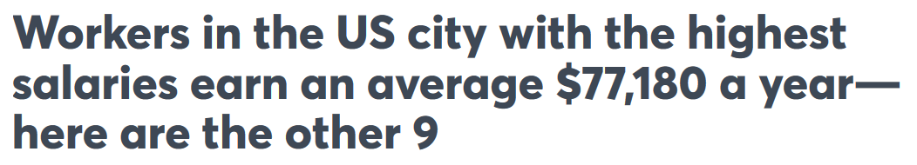

Resources and Challenges
Lists of best cities:
Not especially useful
Generally based on one person’s opinion
City statistics:
Overwhelming in number
Not standardized
Hard to compile and make use of
Solution? YCS

Slide 5
Implementation

Slide 6


Hosting the website
Served locally using Flask
Front-end designed using HTML, CSS, and Javascript
Bootstrap used for cosmetic improvements
Backend written in Python

Slide 7


Data storage and access
Database built using MySQl
Separate tables established to store unrelated data (i.e. city data stored in separate table from user data)
Hosted in the cloud using AWS

Slide 8
Challenges

Slide 9

Data Collection and Normalization
Where to gather information on City Data / Stats?
Used open source repositories (Walkscore, FBI Crime Reports, CurrentResults)
How do we determine what a “good score” is?
What exactly is a 10/10 city for a particular category?
How to we normalize scores to a range of 0 to 10 for easy user consumption?
Data comes in a variety of formats and metrics, how can we boil that down to a score?

Slide 10
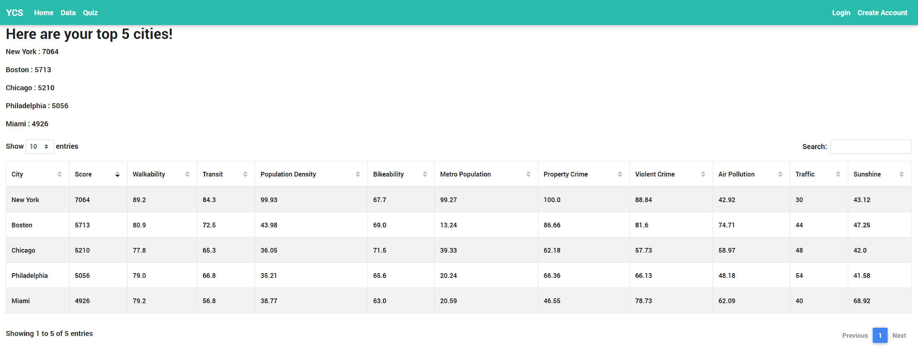
Front End Development
None of us had any real experience with front end development
Needed to figure out how HTML and Javascript worked
How do we integrate these with our Python and SQL back end?
Wreaked a bit of havoc in our class diagram because we didn’t really understand what sorts of components we would need.

Slide 11

Algorithmic choices
What sort of algorithms were even possible to do?
Ended up doing a simple weight gathering technique that does not take into account any previous runs and user response to it.
With no “correct” answers, this sort of task is pretty hard for Machine Learning. Nothing really to “learn” from.
Extension feature: allow users to give their own feedback on cities and matches.

Slide 12
What Makes YCS Special

Slide 13

What Is So Great About YCS?
Indexed results
No need to worry about:
One study vs another
Biased results based on city size
Weighted scores
Choosing factors that matter most to you over others
Category specification
Avoiding certain factors altogether
Solves biggest issue with listicles

Slide 14
How It Works

Slide 15
Navigating the website
Navigation bar located at the top of every page provides links to all of the core services.
Pages that require a user to be logged in will prompt user to login if they haven’t already and redirect to home page.

Slide 16
Viewing the data
The user can view the raw data in an interactable table
The table can be sorted by each column
Specific cities can be searched for

Slide 17
Taking the Quiz
User enters weight of importance for each factor
Upon submission of the quiz, backend will compute top 5 cities based on quiz responses
Results are displayed to user, along with all the data for each of the 5 cities

Slide 18
Future Extensions

Slide 19

Fully fleshing out all aspects of the project
Incomplete features due to lack of time:
Advanced User Profile manipulation
More advanced algorithms
Encryption of user data
Additional quizzes for things like tourism, business development

Slide 20

Additional Data Gathering
Currently only have data on 25 cities, limited to the United States
Would like to expand that to a global level
More granular data as well. Where in New York would you like to move?
Add additional categories
Only 10 categories of data for a user to choose from
Add more like job markets, home value, etc.

Slide 21

User feedback
We don’t actually know how well our suggestions match user expectations
Do they think moving to Detroit is a good idea? Who knows!
Adding a way for Users to submit their own ratings of cities would help improve accuracy
Would provide an actual baseline for more Machine Learning-oriented engineering.

Slide 22
What We Learned

Slide 23

Software Planning
Documenting each process of development
Tracking team member progress
Diagramming :
Use cases
State Diagrams
Class Diagrams
Sequence Diagrams
Gantt chart

Slide 24

Role Distribution
Something very important was distribution of roles
In real software design, having each member dedicated to one element is optimal
With three pieces of our project, this worked out well

Slide 25
Difficulty of speculative planning on unknown tech
Not knowing much about from end software, it was difficult to piece together exactly what classes, functions and models we would need to do anything
Our Class diagram changed quite a bit as a result

Slide 26
Expectations for future classes
Presumably more topics related to management / development techniques like agile vs waterfall.
More advanced diagram types
Interfacing with clients

